Slide 1
Signals and Linear Systems

Slide 2
We discuss the following in Matlab:
-Signal presentation,
-Fourier transform,
-LTI systems
-Signal energy, power, sprectrum, and autocorrelation,
-Lowpass equivalent of bandpass signals
Matlab can only use a discrete-time sampling sequence to represent a continuous-time signal

Slide 3
Signals in Matlab
Impulse signal and sequence
t = -5:0.01:5; y = (t==0); subplot(1,2,1); plot(t, y, 'r’);
n = -5:5; x = (n==0); subplot(1,2,2); stem(n, x);

Slide 4
Signals in Matlab
Step signal and sequence
t =-5:0.01:5;
y=(t>=0);
subplot(1,2,1);
plot(t, y, 'r')
n = -5:5; x = (n>=0); subplot(1,2,2); stem(n, x);

Slide 5
Signals in Matlab
3．Real exponential sequence
n=[ns:nf]; x=a.^n;
4． exponential sequence
n=[ns:nf]; x=exp((delta+jw)*n);
5．Sinine, cosine sequence
n=[ns:nf]; x=cos(w*n+sita);

Slide 6
Signals in Matlab
Other signal generation functions
Name | Description | Name | Description
sawtooth | Sawtooth or triangle wave | pulstran | Pulse train
square | Square wave | rectpule | Aperiod squre wave
sinc | Sinc wave | tripuls | Aperiod triangle wave

Slide 7
Signals in Matlab
Example：square wave
%50Hz,duty cycle is 20％ and 50％, repectively.
和50％的矩形波。
Fs=10000; %Sampling rate
t=0:1/Fs:0.1; %Sampling period
f=50; %50Hz
x1=square(2*pi*50*t,20); %Default period is 2pi
x2=square(2*pi*50*t,50);
subplot(211); plot(t,x1);
subplot(212); plot(t,x2);
Notes:
将周期的问题

Slide 8
Signals in Matlab
Example：Sinc signal
t=linspace(-10,+10,200);
x=sinc(t);
plot(t,x);

Slide 9
Signal Operations
Moving：y(n)=x(n-m)
Periodic extension：y(n)=x((n))_{M}
Flipping：y(n)=x(-n)
y(n)=x(n-m)
y(n)=x(mod(n,M)+1)
y=fliplr(x)

Slide 10
Signal Operations
Correlation with two sequences：
Cummulative sum:
y=xcorr(x1,x2)
y=cumsum(x)
Notes:
画图
----
-----
移动

Slide 11
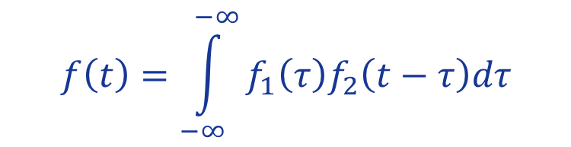
Signal Operations
Convolution of two sequences：
Convolution of two continuous-time signals：
y=conv(x1,x2)
$$f\left(t\right)=\int_{−∞}^{−∞}{f_{1}\left(τ\right)f_{2}\left(t−τ\right)dτ}$$
y=conv(x1,x2)*dt
Notes:
写出积分式，换为求和式

Slide 12
Fourier Transform
Continuous-time，continuous-frequency：FT
Discrete-time, discrete-frequency: DFT / FFT
Notes:
周期信号的傅里叶变换，冲激

Slide 13
Fourier Transform
Fs=1/Ts
Notes:
讲间隔
0dao fs的采样

Slide 14
Fourier Transform
Time domain ：0,Ts,2Ts,…,(N-1)Ts
Frequency domain ：0,1/(NTs),2/(NTs),…,(N-1)/NTs
Notes:
讲间隔

Slide 15
Fourier transform：
function [f,sf]=T2F(t,st)
%input is time and the signal vectors
%output is frequency and signal spectrum
dt=t(2)-t(1); %sampling period
T=t(end)-t(1)+dt; %signal duration
df=1/T; %frequency accuracy
N=length(st);
%frequency[-fs/2,fs/2]
f=-N/2*df:df:(N/2-1)*df; %frequency sequence
sf=fft(st);
sf=T/N*fftshift(sf).*exp(-j*2*pi*f*t(1));
Notes:
画图

Slide 16
Inverse Fourier Transform：
function [t,st]=F2T(f,sf)
%output is time and the signal sequence
%input is frequency and signal spectrum
df=f(2)-f(1);
Fmx=f(end)-f(1)+df;
dt=1/Fmx; %sampling rate
N=length(sf);
T=N*dt;
t=0:dt:T-dt; %time sequence
sff=ifftshift(sf);
st=Fmx*ifft(sff);

Slide 17
Fourier Transform
Problem 1.7
The signal x(t) whose plot is given as follows.
- Plot its spectrum.
If the signal is passed through an ideal lowpass filter with a bandwidth 1.5Hz, plot the output.
If the signal is passed through a filter with impulse response:

Slide 18
Fourier Transform
The signal:

Slide 19
Fourier Transform
Step 1: generate the signal
fs=5; % sampling frequency
ts=1/fs; % sampling interval
t=[-5:ts:5]; % time vector
x=zeros(1,length(t)); % input signal initiation
x(16:26)=t(16:26)+2;
x(27:31)=2*ones(1,5);
x(32:41)=2+2*cos(0.5*pi*t(32:41));
x(42:46)=2*ones(1,5);
Step 2: the spectrum of this signal
[df1,X]=T2F(t,x)

Slide 20
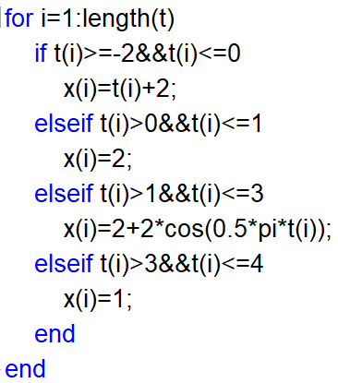
Fourier Transform
Step 1: generate the signal
fs=5; % sampling frequency
ts=1/fs; % sampling interval
t=[-5:ts:5]; % time vector
x=zeros(1,length(t)); % input signal initiation
x(16:26)=t(16:26)+2;
x(27:31)=2*ones(1,5);
x(32:41)=2+2*cos(0.5*pi*t(32:41));
x(42:46)=2*ones(1,5);
Step 2: the spectrum of this signal
[df1,X]=T2F(t,x)

Slide 21
Fourier Transform
Step 3: Filter transfer function
%H=[ones(1,ceil(1.5/df1)),zeros(1,length(X)-%2*ceil(1.5/df1)),ones(1,ceil(1.5/df1))];
H=zeros(1,length(X)); %generate the lowpass fileter
for i=1:length(X)
if abs(df1(i))<1.5
H(i)=1;
end
end
Y=X.*H; % output spectrum
% output of the filter as if the signal starts from 0s
Y=Y.*exp(j*2*pi*df1*t(1));
[t1,y1]=F2T(df1,Y)

Slide 22
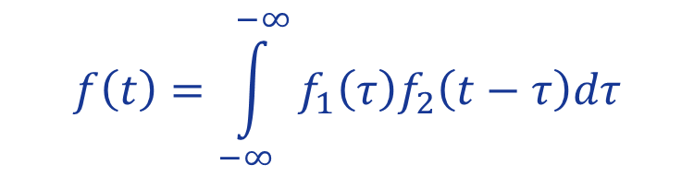
Fourier Transform
Step 4: LTI system impulse response
h=[zeros(1,ceil(5/ts)),t(ceil(5/ts)+1:ceil(6/ts)),ones(1,ceil(7/ts)-ceil(6/ts)),zeros(1,51-ceil(7/ts))];
y2=conv(h,x)*ts; % output of the LTI system
figure(1);
plot(df1, (abs(X)))
figure(2);
plot(t,abs(y1(1:length(t))));
figure(3);
plot([-10:ts:10],y2);
$$f\left(t\right)=\int_{−∞}^{−∞}{f_{1}\left(τ\right)f_{2}\left(t−τ\right)dτ}$$
y=conv(x1,x2)*dt

Slide 23

Energy and Power of the Signal
$$x\left[n\right]=x\left(nΔt\right)$$
Energy：
Power:
MATLAB: E=sum(x.*conj(x))*dt;
E=sum(abs(x).^2)*dt;
MATLAB: P=sum(x.*conj(x))/N;
P=sum(abs(x).^2)/N;

Slide 24


Energy and Power of the Signal
$$X\left[k\right]=X\left(kΔf\right)$$
Energy（F-domain）：
Power（F-domain）: （ is the spectrum of x(t) within [0,T]）
MATLAB: E=sum(x.*conj(x))*df;
or E=sum(abs(x).^2)*df;
MATLAB: P=sum(x.*conj(x))*df/T;
or P=sum(abs(x).^2)*df/T;

Slide 25

Autocorrelation & Power Spectral Density
$$x\left[n\right]=x\left(nΔt\right)$$
Autocorrelation：
Power Spectral Density ：
Wiener-Khinchin theorem ：
MATLAB: R(tau)=sum(x(t).*conj(x(t+tau))*dt/(N*dt);
Notes:
Tau的取值

Slide 26
Energy and Power of the Signal
Problem 1.8：For the following signal with sampling rate 1000Hz, duration 10s. Calculate the power, and the power spectral density.
Step1：generate the signal
ts=0.001;
fs=1/ts;
t=[0:ts:10];
x=cos(2*pi*47*t)+cos(2*pi*219*t);
T=10;

Slide 27
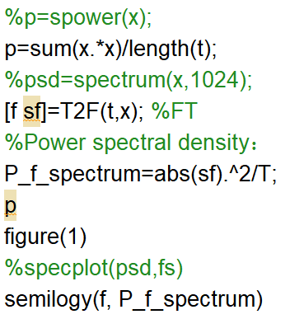
Energy and Power of the Signal
Step2：Power and power spectral density

Slide 28
Energy and Power of the Signal
Step3: calculate the autocorrelation, verify the Wiener-Khinchin theorem
%average autocorrelation
R=xcorr(x);
R=R*ts/T;
%FT of the autocorrelation：
tau=-10:ts:10;
[f1,R_f]=T2F(tau,R);
figure(2)
plot(f1, real(R_f))

Slide 29

Lowpass Equivalent of Baseband Signal
Bandpass signal: （e.g. BPSK，ASK）
Analytic signal ：
Lowpass equivalent：
In-phase and Quadrature component：
$$z\left(t\right)=s\left(t\right)+j\hat{s}\left(t\right)$$
Hilbert tranform
Matlab：hilbert()
Notes:
正频-j，负频j，画图

Slide 30
Lowpass Equivalent of Baseband Signal
Problem 1.9
For the following signal,
(1)Plot the signal and its spectrum
(2)fc=200Hz, Plot the lowpass equivelant and its spectrum.
Hint: the lowpass equivalent in this case is real.
Notes:
正频-j，负频j，画图

Slide 31
Lowpass Equivalent of Baseband Signal
Step1: generate the signal and its spectrum
ts=0.001;
fs=1/ts;
t=[-5:ts:5];
x=sinc(100*t).*cos(2*pi*200*t);
[f,sf]=T2F(t,x); %spectrum
Step2: lowpass equivalent and its spectrum
x_a=hilbert(x); %analytic signal
x_l=x_a.*exp(-j*2*pi*200*t); %lowpass equivalent
[f_l,sf_l]=T2F(t,x_l); %spectrum
Notes:
正频-j，负频j，画图

